Slide 1
ITS 365 Project: Phase 2
By Marcus Nunez & Hakeem Atanda

Slide 2
Project Goals & Differences to Phase 1
The goal Phase 2 was to improve upon the results of Phase 1’s analysis of the CIFAR-10 image dataset by applying and tweaking aspects of transfer learning.
The previous custom CNN model trained only on the provided dataset was replaced by a pre-trained ResNet18, chosen due to instructor suggestion and reputation as a well-supported transfer learning model.

Slide 3
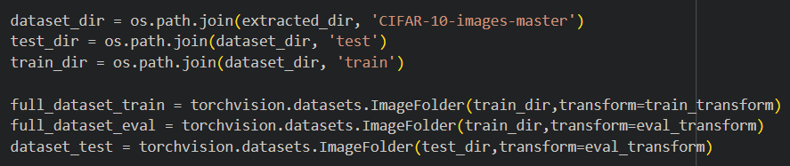
Data Processing
The updated model utilizes the same dataset import process as in Phase 1, extracting the source file with ‘zipfile’, instead being resized exclusively to 224x224 to match the required input of ResNet18.
This is the same reasoning for the replacement of manual to ImageNet normalization and the classification formula to reduce ImageNet to CIFAR-10’s 10 classes.

Slide 4
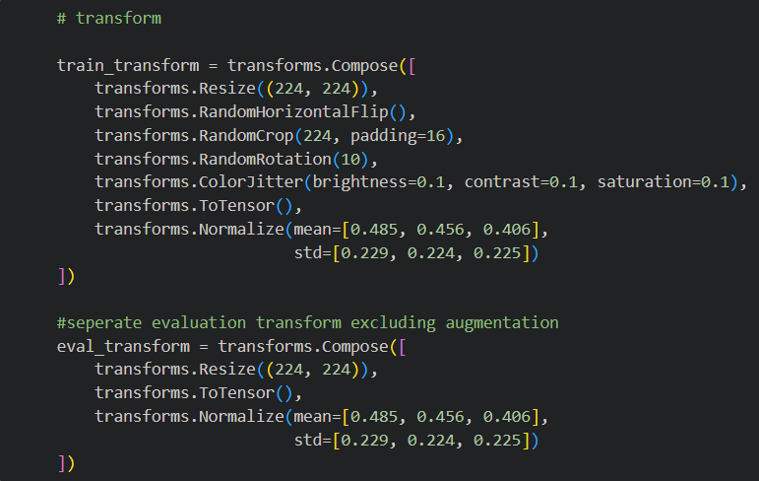
Training - Layer Freezing
The freezing of pre-trained layers was done due to now only needing to train on CIFAR-10 contents specifically, greatly improving speeds. This gained speed was unfortunately lost following the addition of another separated pipeline, giving training and evaluation exclusive transforms for improved generalization.

Slide 5
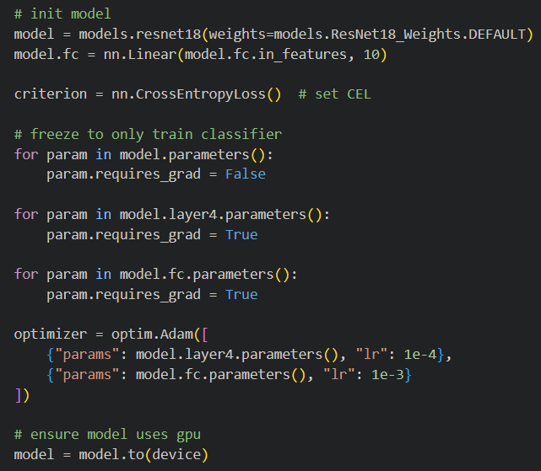
Training (Continued)
The final model selection was also tweaked to include a comparison of validation loss to base further training off of. Together, these modifications (and mostly thanks to work handled by the pre-trained model) allowed for a massive reduction of 50 to 10 epochs with much more favorable results.

Slide 6
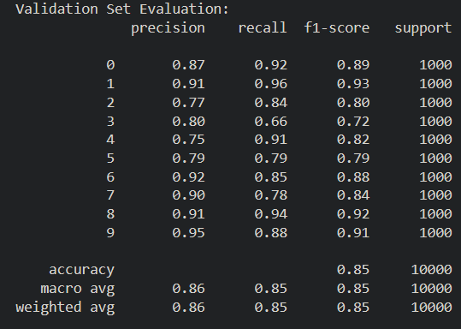
F1 Score & Accuracy
The transfer learning model shows substantial improvement over its derivative, though boasting around the same speed. Phase 1’s model previously achieved an F1 score and accuracy of ~72, whereas the updated model climbed to an F1 score of ~84 and an accuracy of ~84% (~87 was observed, but evidence could not be reproduced timely).

Slide 7
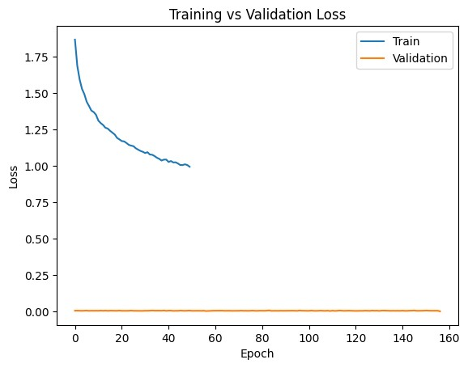
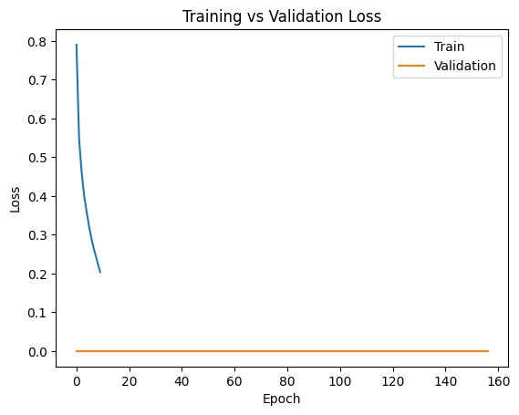
Training Loss
Phase 1 Phase 2

Slide 8
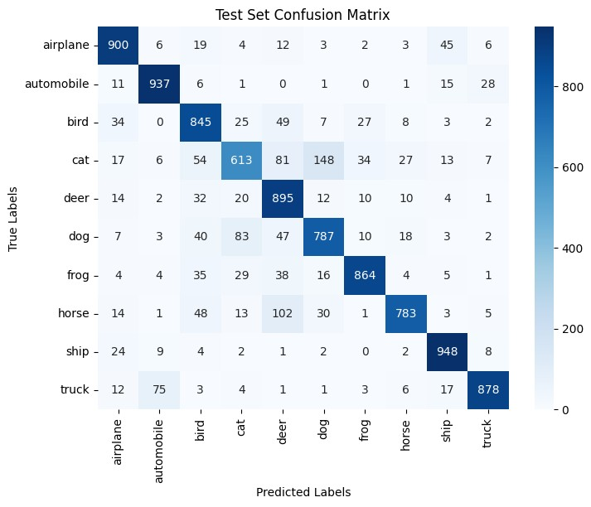
Confusion Matrix
As for the classification report, previous confusion in classes such as between cats and dogs still persists, with the new contender of deer and horses applying to the improved model.

Slide 9
Conclusion
Overall, this meaningful increase from Phase 1 and demonstrates how proper implementation of pre-trained models, which have been understood and perfected over a longer period of time, can produce far greater results in lesser time, making it a valuable tool in machine learning.
While some mistakes such as class confusion may still occur, much of the heavy lifting is taken care of from the start, allowing developers to focus on manual configuration to fix such matters.

